Slide 1
Scientific calculator
Topic: calculator

Slide 2
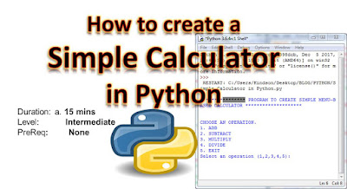

Slide 3
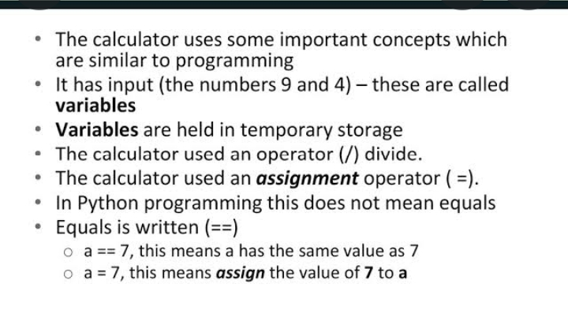

Slide 4
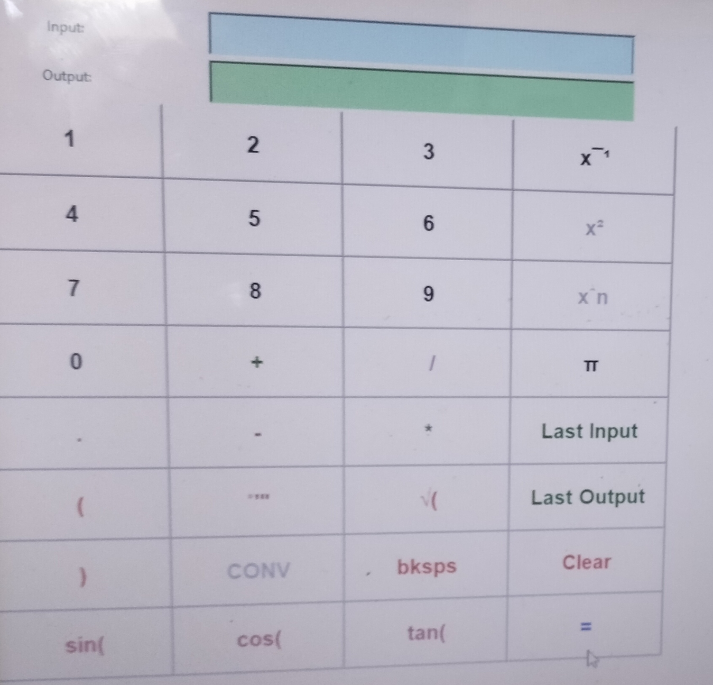

Slide 5
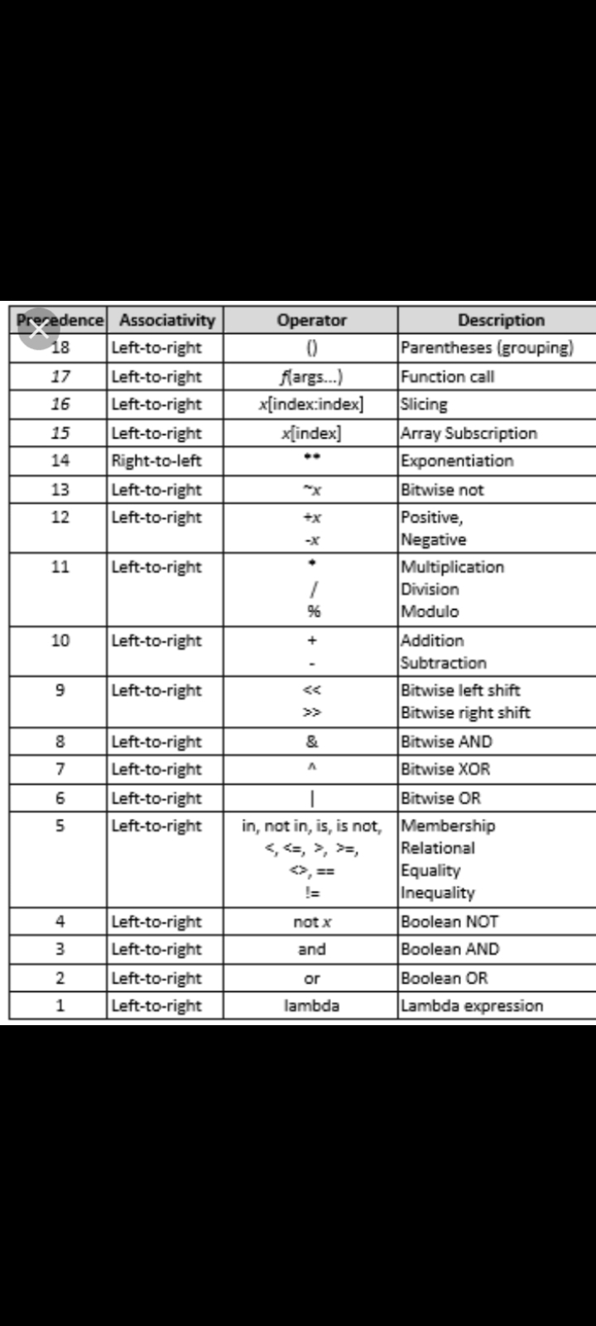

Slide 6
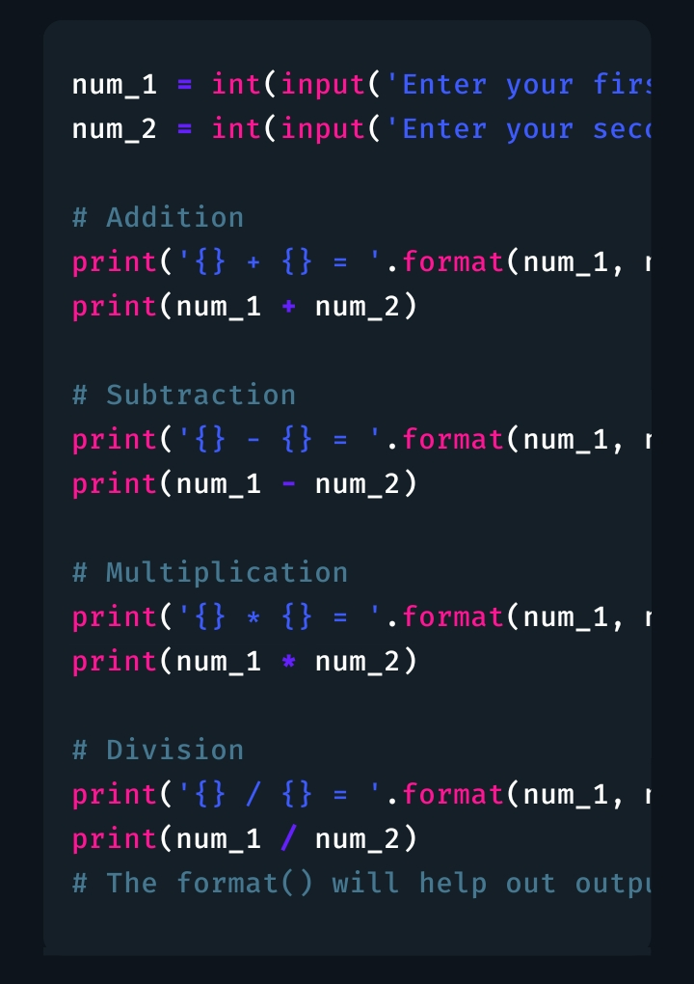

Slide 7
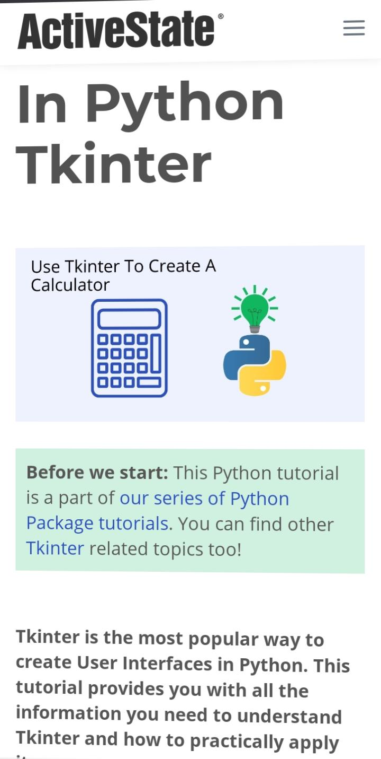

Slide 8
Calculator
Easy to learn
Use very little to make a functional desktop application
Layed design
Portable across all operating system including window,macos and Linux
1.Pre-installed with the standard python library
2.This tkinter tutorial introduces you to the exciting world of GUL programming in python

